Slide 1
DATA SCIENCE- CAPSTONE PROJECT
E-COMMERCE PRODUCT
DELIVERY PREDICTION

Slide 2
Product Delivery Timeliness & It’s Significance
This project aims to enhance the understanding of product delivery patterns and customer behavior for an international e-commerce company specializing in electronic products. By leveraging machine learning, the project seeks to predict whether products will reach customers on time. The goal is to develop robust machine learning models to accurately predict product delivery timeliness, enabling the company to improve customer satisfaction, optimize logistics, and gain insights into factors affecting delivery performance.

Slide 3
Agenda of The Project
Documented machine learning models specifically designed for predicting product delivery timeliness.
Comprehensive data visualizations illustrating relationships between various factors and delivery performance.
A comparative analysis of different machine learning algorithms for this classification task.

Slide 4
PROJECT GUIDELINES
Data Exploration & Preprocessing
Feature Engineering & Encoding
Model Selection & Training
Hyperparameter Tuning
Model Evaluation
Feature Importance Analysis
Results & Business Insights

Slide 5
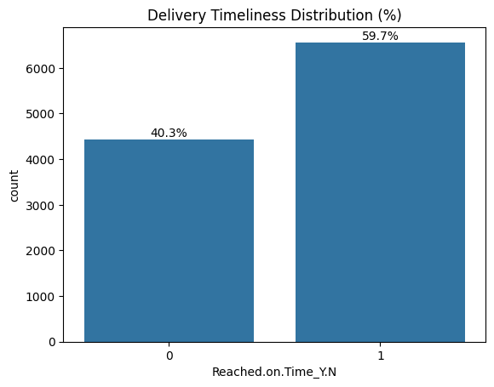
Data Exploration & Preprocessing
Exploratory Data Analysis
Examined dataset structure and feature distributions
Analyzed delivery outcome patterns in the dataset
Key Observation
Around 59.7% of deliveries were delayed while 40.3% were delivered on time, indicating moderate class imbalance.

Slide 6
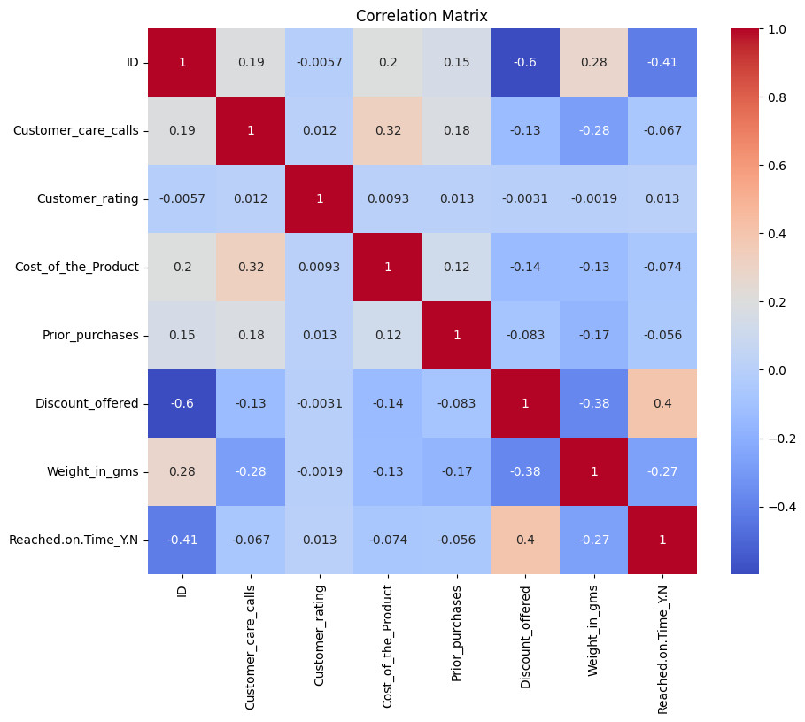
Feature Relationships & Correlation Analysis
Correlation Analysis
Examined relationships between numerical features
Identified variables that influence delivery timeliness
Key Insights
Discount_offered shows the strongest relationship with delivery outcome
Weight_in_gms also shows moderate influence
Other features show weaker correlations

Slide 7
Feature Engineering & Encoding
Feature Engineering
Selected relevant variables influencing delivery performance
Separated features and target variable for modeling
Analyzed feature relationships with delivery status
Encoding & Scaling
Applied One-Hot Encoding for categorical variables
Applied Ordinal Encoding for ordered features
Standardized numerical features using StandardScaler

Slide 8
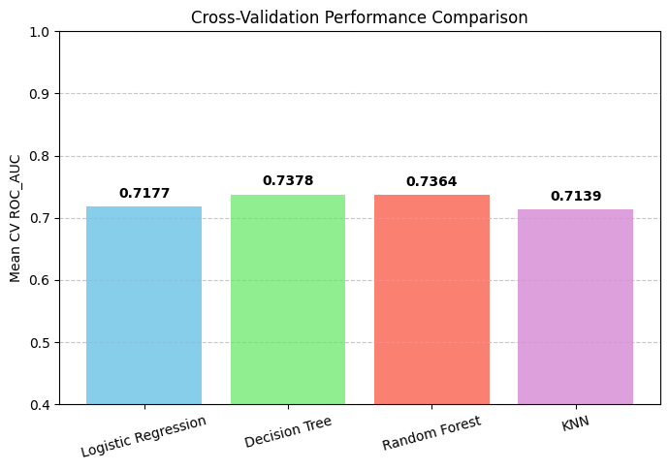
Model Selection & Training
Machine Learning Models Evaluated
Logistic Regression
Decision Tree
Random Forest
K-Nearest Neighbors
Training Process
Dataset split into Training and Testing sets
Stratified sampling used to maintain class distribution
Cross-validation used to evaluate model performance

Slide 9
Hyperparameter Tuning
Model Optimization
Hyperparameters adjusted to improve model performance
Controlled model complexity and overfitting
Examples of tuned parameters:
Decision Tree → max_depth
Random Forest → number of estimators
Logistic Regression → regularization strength

Slide 10
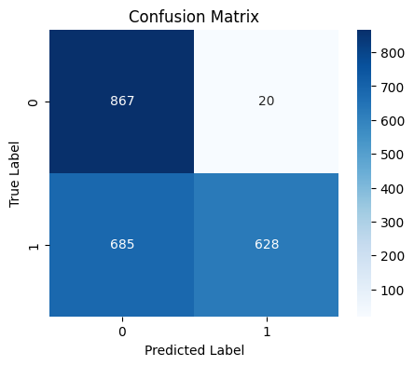
Model Evaluation
Evaluation Metrics Used:
Accuracy
Precision
Recall
F1 Score
ROC-AUC Score
Confusion Matrix
Key Result
The selected model achieved strong predictive performance, showing good ability to distinguish between on-time and delayed deliveries.

Slide 11
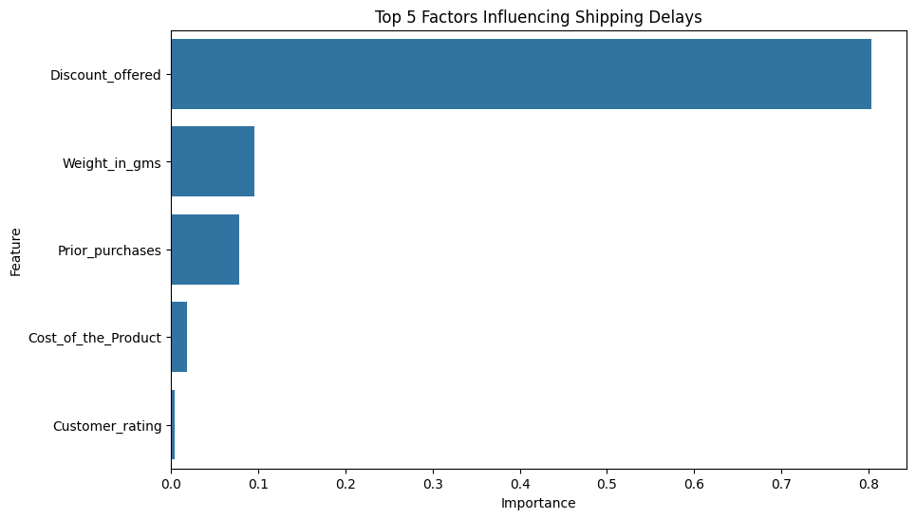
Feature Importance Analysis
Important Factors Affecting Delivery Timeliness
Discount_offered
Weight_in_gms
Prior_purchases
Shipping characteristics
Key Insight
Discount strategies show a strong relationship with delivery delays, suggesting promotional campaigns may influence logistics performance.

Slide 12
Project Benefits & Business Insights
Project Benefits
Enables prediction of delivery delays before shipment completion
Helps companies plan logistics operations more effectively
Supports data-driven decision making
Business Insights
High discounts are strongly associated with delayed deliveries
Certain shipment characteristics increase delay risk
Predictive analytics can improve customer experience

Slide 13
Questions ?

Slide 14
Thank You!

